Slide 1

CFPB Complaint Modeling
Zachary Carideo

Slide 2
CFPB Complaint Analysis Steps
Data Profiling
Model Training, Tuning, and Evaluation
Results Overview
Risk based Output prioritization
Data Preprocessing
Focus of Analysis
Many important data profiling and integration of model outputs into downstream LOB tools have been summarized but are not the focus on this analysis
All Code and Deliverables at below git@github.com:zack-carideo/qas4_casestudy.git

Slide 3
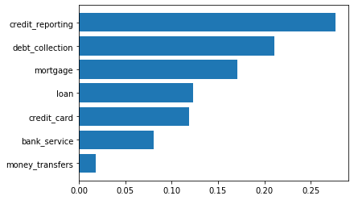
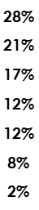
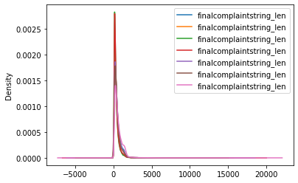
Response Variable Data Challenges
Target Imbalance: Imbalanced target level distribution needs to be addressed to account for imbalance in money transfers and bank service relative. The Imbalance is not extreme, so instead of sacrificing integrity of target we oversampled the rare target event.
Target Imbalance Solution
BOW Models -> Oversample rare target levels
Sequence models -> Under sample common target levels OR Specify class weights in the model architecture so Keras/TF
Under sampling used only for sequence model to reduce training time but still retain representative sample of the data.
Product | Mean Length | std | min | 0.25 | 0.5 | 0.75 | max
bank_service | 87 | 72 | 14 | 40 | 65 | 110 | 1211
credit_card | 83 | 70 | 15 | 39 | 63 | 103 | 1950
credit_reporting | 66 | 61 | 6 | 32 | 48 | 78 | 1628
debt_collection | 67 | 62 | 13 | 31 | 48 | 80 | 1953
loan | 83 | 73 | 15 | 38 | 61 | 103 | 2048
money_transfers | 82 | 81 | 18 | 37 | 60 | 98 | 1910
mortgage | 103 | 93 | 15 | 46 | 77 | 134 | 2758
Text Length: large variance between avg and max length of sequences , this may slow sequence model training and should truncate text sequences to the 90% perctile in future
Text Length Solution
BOW Models -> No issue TFIDF is used to reduce number of features considered
Sequence models -> Truncate text sequences to a standard 2000 words long(this is > the 85% for all target class levels)*
*for model POC, max(sequence_length) was used for training sequence model

Slide 4
Examples of Additional EDA
Understanding how the language associated with complaints varies across target levels can help us get a preliminary idea of
Explore collapsing target levels : Identify target levels with overlapping word distributions
Identify and normalize duplicate complaints: Identify and standardize subgroupings of highly correlated complaints that have the same target product
Enrich feature set: incorporate cluster assignments from k-means analysis as an independent variable to consider in models
Trends in complaints by Product Group over time
How has the distribution of complaints by Product Group evolved over time?
Identify Emerging Complaint Themes within each Product Group
NMF or LDA on BOW visualized via TSNE or PCA’s with hue representing target level to understand the topics associated with each of the products
Evaluate topics with respect to time to proactively id sub-topics of complaints that we will likely see in the future

Slide 5
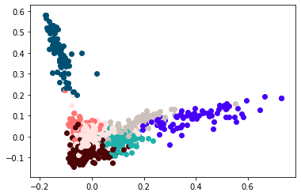
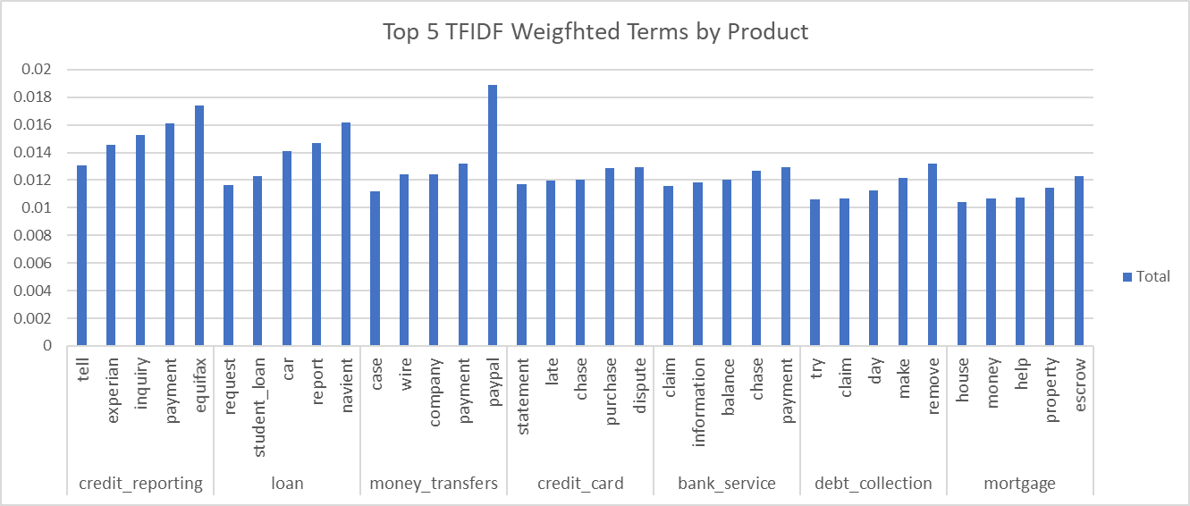
Examples of Additional EDA
Mortgages should be a very easy level for the model to predict
Explore collapsing target levels via cluster analysis and PCA
text
Tf-idf matrix
Kmeans
nclusters=n_targ_leves
Pca(clusters)
Plot top 2 pcas hue = cluster
Evaluate top terms per Product Group and key clusters of text within each

Slide 6
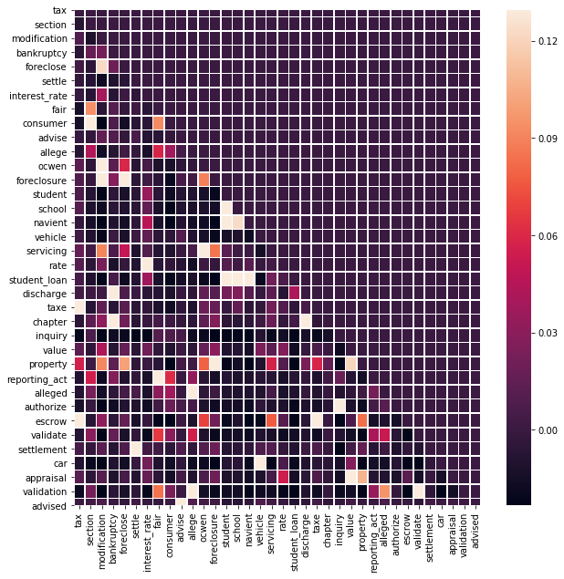
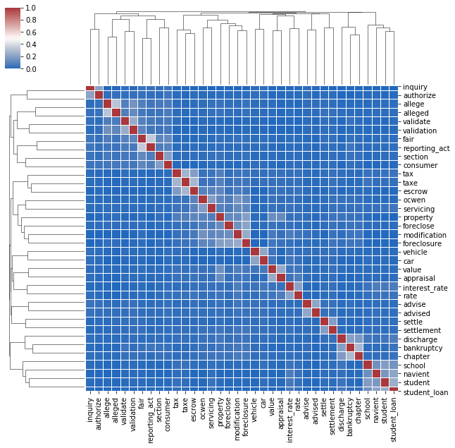
EDA Continue
Identify micro-clusters of terms always found together within each Product Group , these patterns can be used as BUISNESS OVERLAYS to the model
(if these words are found in the complaint, they are automatically routed to a specific department regardless of model prediction)
Visually inspect Identify Highly correlated terms to generate phrases from
mortgages
Debt Collection
Student Loans

Slide 7
End 2 End Model Development Process
The model development process for both BOW models and embedding based sequence models is shown below
BOW MODELS
The full e2e model development process was implemented for BOW based models and the selected champion model was saved as a binary
Clean text
TFIDF
Feature Selection
Over Sample Rare
Build suite of BOW classifiers
Evaluate and id champion
HP Tuning and CV on champion
Report and Save Final Model
Seq2Seq MODEL
The sequence model development process was consolidated, CV and HP were not conducted. However, we evaluate model fit with a hold out sample during training(similar to OOB sample validation used in RF / GBM) so impact of no CV should be minimal.
Clean text
Sequence Generation
Embedding mapping
Under Sample*
Train Model**
HP Turning
Report and Save Final Model
*under sampling used for POC for 2 reasons: 1) ensure representative sample of each product group , 2) reduce training time for POC
** we establish confidence in model performance and stability during the training process via scoring a hold out at end of each epoch of training

Slide 8
Model Feature Space
2 types of features spaces were used
BOW baseline models using TF-IDF Matrix Weights:
Baseline models built using sklearn pipelines that can be built fast, searlized , and re-used to score new data with minimal effort.
Provides explainable baseline model to use in evaluating the trade off between complexity and within class accuracy
Sequence challenger model using embedding based sequences :
Single LSTM architecture with embedding layer used
Incorporates additional information over BOW approach related to the sequence in which words are used both forward and backward
Leverages embedding model instead of BOW so semantically similar phrases and words the model was not trained on will still generate strong results (no issue with model seeing words in test data that were not in training data)
Challenge | Solution
Model cannot interpret text / input variables that it was not trained on (Poor Generalization) | Leverage embedding based model as a challenger to capture semantic and sequential interactions lost in TFIDF
Challenge | Solution
Resource intensive training requiring GPU | Leverage Pymagnitude compression and query optimization framework to enable sequence model training on CPU in reasonable time (< 4 hours)
Overfitting | Leverage Dropout layers in model architecture to minimize risk of overfit
Explainability | Add Attention layer prior to dense output layer to allow identification of sequence importance
Identifying meaningful term/doc frequency relationships and fine tuning a text-based BOW classifier can be time and resource intensive. Further, due to continuously evolving context of complaints, BOW models can suffer from extreme degradation of model performance as complaint utterances begin to diverge from what the model was trained on. These issues are avoided when using embedding based models.
BOW models cannot derive meaning from out of vocabulary(OOV) tokens, embedding based models easily correlate semantic meaning of tokens the model was trained with to new vocabulary seen in out of sample scoring(production data).
Minimal text preprocessing is required to generate strong baseline performance, whereas significant cleaning and use case specific logic must be injected into text-preprocessing activities prior to building a BOW classifier.
Seamless incorporation of new training data: Leverage model checkpointing to allow batch level updates to existing model weights to capture new relationships as data becomes available
Easy Evaluation: Embedding models used can be quickly interchanged and evaluated to allow each model to be highly generalizable.
Easy to identify sequence drivers: Model Predictions can be justified and visualized quickly via attention level evaluation of an individual sequence.
Time-consuming tasks required when using BOW models , that do not generalize well to out of sample data include.
Custom NER tagging to remove common use case specific names/places/phrases
Generation of significant n-grams to be converted into single tokens for bow based models
Removal of insignificant words / Parts of speech in sequence (terms/phrases with low tf-idf weights, and those outside min-freq, max-freq)
Stemming and lemmatization of tokens
Handling / removing punctuation

Slide 9
Model Selection
Challenger Model Architectures
(BOW Models)
Sequence
LSTNM with
Embedding Layer
3 Model Frameworks were evaluated
Baseline Linear Model: Logistic regression using tfidf weights for features. Used in evaluating trade off between complexity and performance
Ensemble Frameworks: Stochastic approaches using tfidf weights for features. Also considers higher order interactions across the features space.
Evaluates interactions
↑ generalization on out of sample data
↓ bias associated with single model outcomes by averaging results from multiple weak learners into a single strong learner.
Sequence DL Frameworks:
↑ generalization
Captures information related to the sequence in which words are used
Minimal Preprocessing required
Training and scoring is resource intensive
transfer learning applied to speed up training and maximize generalization
Text: Input Layer
Random Forest
Logistic Regression
SVM
GBM
PYMAG Embedding
Embedding Layer: Input Layer
1d CONV
1D Max Pooling
TFIDF
Gaussian Dropout (add noise)
Feature dataset
Challenger models
Champion model
SELU Activation
P(Loan)
BILSTM
(100 nodes)
P(Bank Service)
P(Credit Card)
Dropout
P(Credit Reporting)
P(Debt Collection)
SELU activation
P(Mortgage)
Dense Layer: Classification (Softmax)
7 neurons
P(Money Transfer)

Slide 10
Variable Selection and Data Sampling
Data Sampling
BOW Models
No Sampling , all data used
Seq2Seq LSTM model
4000 records from each class(4000 is the total number of records in rarest class) used for training
Transfer learning in Keras sequential API used to account for loss of information due to sampling
Model leverages pre-trained FASTTEXT embedding layer to reduce labels per class needed for training.
Variable Selection
BOW baseline models:
Random Forest used to identify preliminary set of n candidate features for non ensemble based models (logistic)
Feature set further subset at training to 200 max features(to minimize training time and prevent overfitting linear models)
Sequence challenger model
Remove extreme common words to reduce sequence length (use genism)
Dropout and Recurrent Dropout is heavy leveraged to prevent the LSTM from biasing specific relationships found in data to arrive at target predictions
FUTURE Enhancements to feature space to maximize information available to model
Incorporate numeric and categoric variables in addition to tfidf / embedding vectors via feature union.
Ex. Total accounts , Total past complaints , Location of customer
Incorporate TIME dependent indicators (economic indicators ) by leveraging time of complaint as join key.
Do rising unemployment rates influence the number of complaints associated with payday loans?
Do rising interest rates help inform the volume of debt collection related complaints?

Slide 11
Data Preprocessing BOW Models
Data preprocessing tasks for BOW model is resource intensive and requires removing a lot of useful information that a more advance model (sequence based models) can leverage to improve accuracy.
De-accent
remove stop words & Stop Phrases
replace contractions
remove dollars , dates, text in parentheses
remove emails , URLs
remove special characters
Generate Phrased Tokens
lemma text

Slide 12
Data Preprocessing Embeddings
Data preprocessing tasks for embedding model is highly simplified relative to traditional BOW model text preprocessing requirements, below highlights the preprocessing steps taken to prepare the complaints for modeling with embeddings.
Text Preprocessing*
Remove masked text (ex. xxxx)
Remove Dollars
Embedding Sequence Generation
Remove repeat occurrences of words, punctuation, and white space
Generate numeric hash map for each word in training data
Deaccent
Remove sentences with < 3 words
Remove text in parentheses
Convert sentences into sequences using HashMap
Determine the max sequence length to consider
Pad all sequences to an equal length
NOTE: The model build process takes the embedding vectors and transforms those embeddings into features as part of generating embedding layer
Convert sequences into embedding vectors
EMBEDDING LAYER
(output of sequence generation, used as first layer in sequence model)
* stop word removal and lemmatization ONLY used to reduce sequence size for training!!

Slide 13
BOW Model Results Overview
Initial BOW Candidate Model Performance
Accuracy Metric for multi-class outcome
balanced accuracy was used to evaluate all metrics given the multi-class nature of the model
This is HIGHLY conservative , weights accuracy across each class equally, regardless of support
Balanced Accuracy = Avg of recall obtained from each class!
Considerations
All models restricted to 200 features at most to speed up training
Oversampling was used to correct for imbalance
OOB CV was used for all stochastic based models (GBM , RF)
For logistic regression variable selection was conducted using a stochastic tree based approach.
Accuracy Report | model | data | logloss | accuracy | recall | precision | f1_score | fbeta_score | mae | mse
CHAMPION | GBM | train | 0.943952 | 0.69069 | 0.69069 | 0.720546 | 0.69945 | 0.704259 | 0.673703 | 2.037251
BASELINE | Logistic | train | 0.939374 | 0.678041 | 0.678041 | 0.708586 | 0.687591 | 0.692459 | 0.710029 | 2.179999
0 | Random Forest | train | 1.491382 | 0.633335 | 0.633335 | 0.685023 | 0.646416 | 0.654872 | 0.804492 | 2.432702
CHAMPION | GBM | valid | 0.976071 | 0.678958 | 0.678958 | 0.710646 | 0.689018 | 0.694038 | 0.705443 | 2.147335
BASELINE | Logistic | valid | 0.947774 | 0.677223 | 0.677223 | 0.708467 | 0.687221 | 0.692179 | 0.713708 | 2.190123
0 | Random Forest | valid | 1.498175 | 0.63044 | 0.63044 | 0.681324 | 0.643743 | 0.652025 | 0.817594 | 2.492739

Slide 14
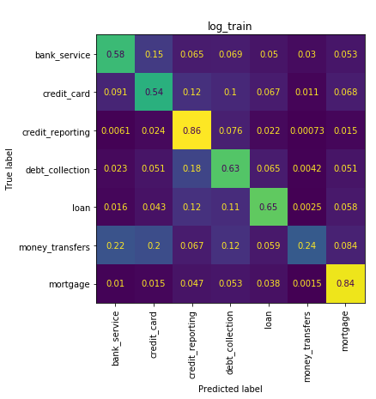
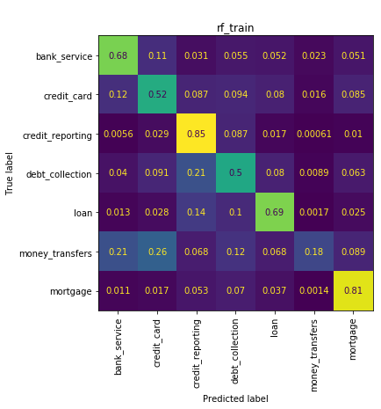
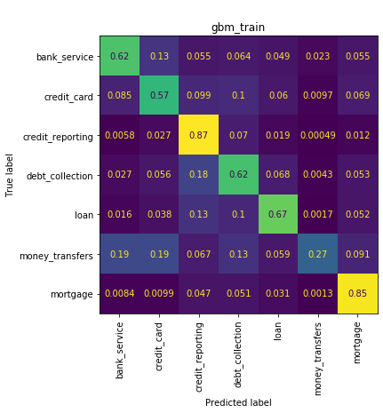



CONFUSION MATRIX OVERVIEW BY CANIDATE MODEL

Slide 15
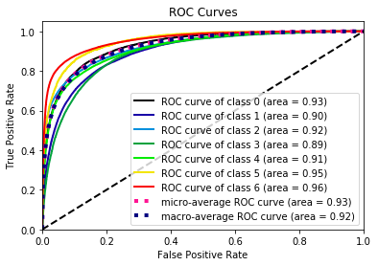
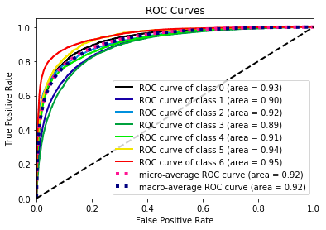
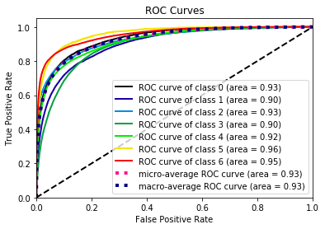
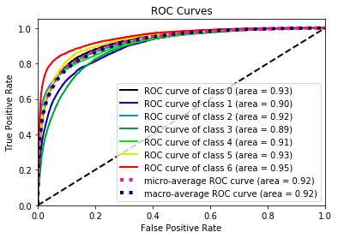
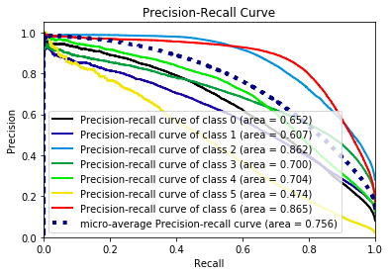
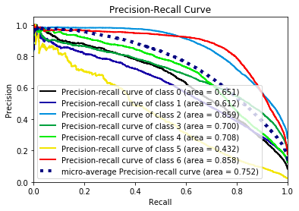
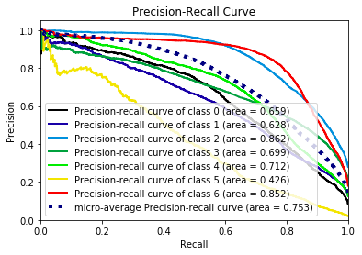
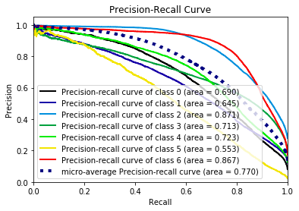
ROC is good indicating we capture majority of TP in AGGREAGATE
Logistic
GBM
train
valid
train
valid
ID | Target Level
0 | bank_service,
1 | credit_card,
2 | credit_reporting,
3 | debt_collection,
4 | loan,
5 | money_transfers,
6 | mortgage
DUE TO CLASS IMBALANCE, WE CANNOT JUST RELY ON ROC CURVES, WE MUST LOOK AT PRECISION / RECALL TO UNDERSTAND MODEL PERFORMANCE
Precision recall curves indicate we cannot capture per class relationships very well

Slide 16
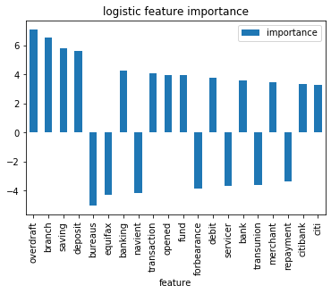
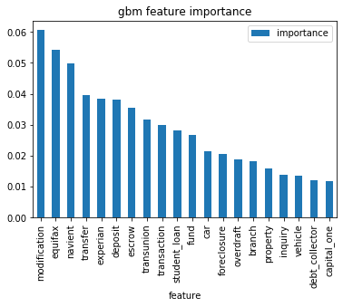
Variable Importance Illustration of variable importance for the baseline logistic and champion GBM are provided below
ID | Target Level
0 | bank_service,
1 | credit_card,
2 | credit_reporting,
3 | debt_collection,
4 | loan,
5 | money_transfers,
6 | mortgage
Logistic Variable importance Must be interpreted with respect to a reference level.
Reference level is the first level of the target (bank servicing)
- GBM Variable Importance if absolute variable importance of the features
THIS MUST BE STRATIFED ACROSS TARGET LEVELS TO UNDERSTAND EACH TARGET LEVEL DRIVERS

Slide 17
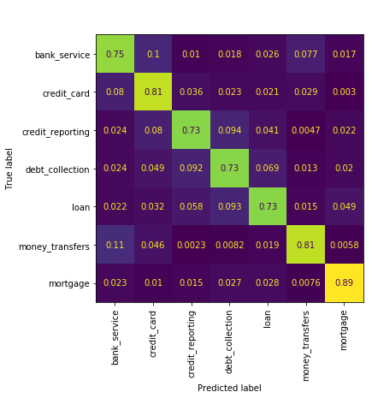
Model Results Embedding based Model
LSTM Confusion Matrix Train
Embedding based model trained on sample of 4000 records from each target class
Advantages of embedding based NLP model
Generalizes much better on OOS data
Drastically outperforms BOW based models
Can be used in conjunction with time based covariants
Disadvantages of embedding based model
Requires extensive resources to train and score new data
Requires TIME to determine core model drivers and identify
 | Bank Service | Credit Card | Credit Reporting | Debt Collection | Loan | Money Transfers | Mortgage
Bank Service | 75.8% | 10.0% | 1.5% | 4.0% | 2.5% | 4.8% | 1.5%
Credit Card | 9.4% | 78.0% | 3.0% | 5.6% | 2.3% | 1.8% | 0.0%
Credit Reporting | 2.0% | 5.8% | 71.3% | 13.8% | 5.5% | 0.1% | 1.6%
Debt Collection | 2.4% | 4.3% | 7.0% | 76.5% | 7.3% | 0.5% | 2.1%
Loan | 3.8% | 5.3% | 4.6% | 8.4% | 75.3% | 0.8% | 2.0%
Money Transfers | 14.1% | 5.5% | 0.4% | 1.3% | 0.8% | 77.9% | 0.1%
Mortgage | 5.4% | 1.8% | 3.3% | 3.3% | 3.1% | 0.8% | 82.5%
LSTM Confusion Matrix Test

Slide 18
Hyper Parameter Tuning and CV on GBM
GBM selected as champion model from initial BOW model evaluation. Below provides overview of the hyper-parameter tuning process and CV results for the GBM model
Random Grid search was used due to time
3 fold CV used on top of existing OOB validation conducted during training of model
Top Scoring combination results in ~65% balanced accuracy on hold out
random run | mean_fit_time | param_clf__subsample | param_clf__n_estimators | param_clf__min_samples_split | param_clf__min_samples_leaf | param_clf__max_features | param_clf__max_depth | cv1 | cv2 | cv3 | mean_test_score | std_test_score | rank_test_score
4 | 1718.515521 | 0.7 | 300 | 5 | 5 | 300 | 10 | 0.655104 | 0.656439 | 0.652183951 | 0.654575569 | 0.001776774 | 1
3 | 2050.155314 | 0.5 | 200 | 10 | 5 | 300 | 20 | 0.645885 | 0.649229 | 0.644918414 | 0.646677646 | 0.001847043 | 2
6 | 5368.101496 | 1 | 300 | 10 | 2 | auto | 10 | 0.647098 | 0.647683 | 0.643846664 | 0.646209094 | 0.00168746 | 3
2 | 4840.299363 | 1 | 200 | 10 | 2 | auto | 10 | 0.64445 | 0.641418 | 0.642529437 | 0.642799083 | 0.001252598 | 4
1 | 1256.90407 | 1 | 100 | 10 | 5 | 300 | 10 | 0.642446 | 0.643275 | 0.640625689 | 0.642115392 | 0.001106454 | 5
0 | 2549.775668 | 0.7 | 200 | 2 | 2 | 200 | 20 | 0.641213 | 0.642918 | 0.639663409 | 0.641264626 | 0.001329038 | 6
8 | 5573.469372 | 1 | 100 | 10 | 5 | auto | 20 | 0.639935 | 0.639946 | 0.636096029 | 0.638659029 | 0.00181232 | 7
5 | 983.641717 | 0.5 | 100 | 10 | 2 | auto | 10 | 0.636381 | 0.636673 | 0.632935763 | 0.635329949 | 0.001697156 | 8
7 | 2264.915548 | 1 | 100 | 2 | 1 | 300 | 20 | 0.634581 | 0.630648 | 0.630992471 | 0.632073906 | 0.001778204 | 9
9 | 617.0392985 | 1 | 50 | 5 | 1 | auto | 5 | 0.606242 | 0.603113 | 0.602162014 | 0.603839135 | 0.001743016 | 10

Slide 19


Confusion matrix for model selected by grid search (Not Final Model, results on the train / validation data the grid search process was trained and tested against)
Findings
Issue: Model appears to be overfitting or cannot identify patterns in rare target levels
Root Cause: Oversampling was not performed on champion model HP tuning or model, this likely is the cause of poor generalization in Money Transfer , which the model misclassifies as Bank Servicing or Credit Cards over 40% of the time
Is Model Overfitting???
No, model is not overfitting based on
CV results show highly consistent performance
hyper-parameters selected are very conservative,
Validation Dat | Bank Service | Credit Card | Credit Reporting | Debt Collection | Loan | Money Transfers | Mortgage
Bank Service | 63% | 16% | 4% | 7% | 3% | 3% | 3%
Credit Card | 8% | 63% | 9% | 12% | 4% | 1% | 3%
Credit Reporting | 1% | 2% | 83% | 9% | 3% | 0% | 2%
Debt Collection | 1% | 4% | 10% | 76% | 5% | 0% | 3%
Loan | 2% | 4% | 7% | 13% | 67% | 0% | 6%
Money Transfers | 28% | 20% | 3% | 13% | 2% | 30% | 4%
Mortgage | 2% | 4% | 3% | 6% | 3% | 0% | 82%
Training Data | Bank Service | Credit Card | Credit Reporting | Debt Collection | Loan | Money Transfers | Mortgage
Bank Service | 84% | 5% | 3% | 5% | 1% | 0% | 2%
Credit Card | 3% | 81% | 6% | 8% | 2% | 0% | 1%
Credit Reporting | 0% | 2% | 89% | 6% | 1% | 0% | 1%
Debt Collection | 1% | 2% | 6% | 87% | 3% | 0% | 2%
Loan | 1% | 3% | 4% | 8% | 81% | 0% | 2%
Money Transfers | 2% | 3% | 1% | 3% | 0% | 89% | 1%
Mortgage | 1% | 2% | 2% | 3% | 1% | 0% | 91%

Slide 20
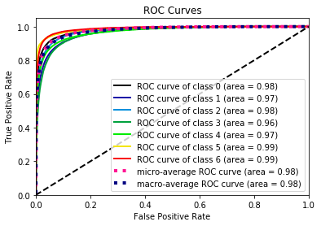
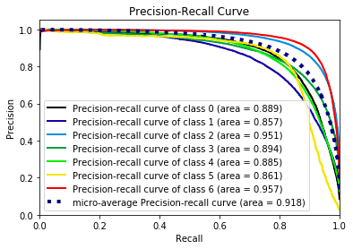
Final Model Specification
Final GBM Model was fit with the below model parameters on the FULL dataset.
Fitting on all data ensures we maximize the information the model has to use when scoring new data
Based on the Grid search results, and the full model output, it appears have OVERFIT the model , however this conflicts with CV results and highly conservative final model parameters. We need to go back and
Oversample rare target even in final model training
add more REGULARLATION to the model specification to ensure overfit not an issue
Add a third ‘test’ holdout to enable us to evaluate the model fitted on full population (we cannot evaluate model fit on our final model)
model | logloss | accuracy_score | recall | precision | f1_score | fbeta_score | mae | mse
GBM | 0.527144 | 0.842115 | 0.842115 | 0.843446 | 0.842201 | 0.842433 | 0.32599 | 0.937969

Slide 21
Final Decision
GBM
Embedding Model
Overfitting or unbale to capture relationships in rare target levels due to lack of oversampling and minimal hp tuning
More time would ensure we evaluate all hyper parameters to prevent overfitting
DO NOT USE GBM over EMBEDDING model due to lack of generalization
Consistent results across training and validation datasets indicate model is not overfitting and can generalize to new data
WE DID NOT HAVE TO USE ALL THE DATA TO TRAIN THIS MODEL
Model scoring speed almost as fast as GBM due to use of pymag embeddings

Slide 22
Full Model Use and Enrichment for LOB
This diagram illustrates how the output from the classification model can be enriched for downstream use by expanding the feature grid to include the other attributes provided in the CFPB dataset, as well as calculating the sentiment of each compliant to enable the output to be prioritized by 1) Probability Decile of being Correct , 2) within each decile, rank complaints in order sentiment to prioritize the most extreme complaints first.
Preprocess Categorical Features
Final input feature dataset
Preprocess
text
Text Preprocessing
Train / Tune / Report
Activation Function
Model Predictions
Final Model Predicted Probabilities by Target Level
Sequence Preprocessing
Target Preprocessing
HyperParam Tuning
Checkpoint
Monitoring
Cross Validation
Final Model
Sentiment Model
VADER
2 stage prioritized output for Product Groups
Actual
Future

Slide 23
APPENDIX

Slide 24
Model Selection Methodology
To build an effective e2e NLP model pipeline in 3 days, including cross validation and hyperparameter tuning, a highly generalizable framework is needed. Traditional BOW model architectures require extensive text preprocessing and leave little time for model development. Below highlights the key criteria that led me to use an embedding based model approach over traditional BOW architectures. Specifically embedding models are Easily re-trainable, maintainable, and generalizable.
Identifying meaningful term/doc frequency relationships and fine tuning a text-based BOW classifier can be time and resource intensive. Further, due to continuously evolving context of complaints, BOW models can suffer from extreme degradation of model performance as complaint utterances begin to diverge from what the model was trained on. These issues are avoided when using embedding based models.
BOW models cannot derive meaning from out of vocabulary(OOV) tokens, embedding based models easily correlate semantic meaning of tokens the model was trained with to new vocabulary seen in out of sample scoring(production data).
Minimal text preprocessing is required to generate strong baseline performance, whereas significant cleaning and use case specific logic must be injected into text-preprocessing activities prior to building a BOW classifier.
Seamless incorporation of new training data: Leverage model checkpointing to allow batch level updates to existing model weights to capture new relationships as data becomes available
Easy Evaluation: Embedding models used can be quickly interchanged and evaluated to allow each model to be highly generalizable.
Easy to identify sequence drivers: Model Predictions can be justified and visualized quickly via attention level evaluation of an individual sequence.
Time-consuming tasks required when using BOW models , that do not generalize well to out of sample data include.
Custom NER tagging to remove common use case specific names/places/phrases
Generation of significant n-grams to be converted into single tokens for bow based models
Removal of insignificant words / Parts of speech in sequence (terms/phrases with low tf-idf weights, and those outside min-freq, max-freq)
Stemming and lemmatization of tokens
Handling / removing punctuation

Slide 25
Embedding Sequence generation
Below provides over of the methodology used to transform complaints into sequences of tokens which directly map to a vectorized embedding representation of each word in each sequence.
Tokenization is the process of converting a string of text into a list of tokens (individual words/punctuation) and/or token IDs (integers that map a word to a vector representation of that word in an embedding array)
Word tokenize texts into ‘tokens’
Leverage wordpiece algo to identify commonly seen subwords of OOV tokens
Transform word tokens into vocabulary(hashed) tokens for use in building vectorized embedding representations of each sequence based on vocabulary BERT was originally built from
Generate sequence representation of texts including padding, truncation , and start and end of text indicators
Padding : if len(txt.split()) < 512 -> pad = 512-len(txt.split()
Truncation: if len(txt.split())> 512 -> txt = txt[:512]
Add BERT delimiters: txt = [CLS] , 1,5012,3413,3414,4144,[SEP]
1500 word long review
200 word chunk(t)
chunk(t)[150:] + 150 new words
chunk(t+1)[150:] + 150 new words
chunk(t+n-1)[150:] + 150 new words
…
Y= mortgage
Y= mortgage
Y= mortgage
Y= mortgage
SEQUENCE MODEL PREDICTIONS
Article prediction= max(avg(p(y_level_i)))
Note: The texts being tokenized are longer than a few sentences, and thus is recommended to generate overlapping chunks of smaller text use these to create a vectorized representation of the longer text that can be used in downstream models without forcing the model to evaluate all the sequences at one pass

Slide 26
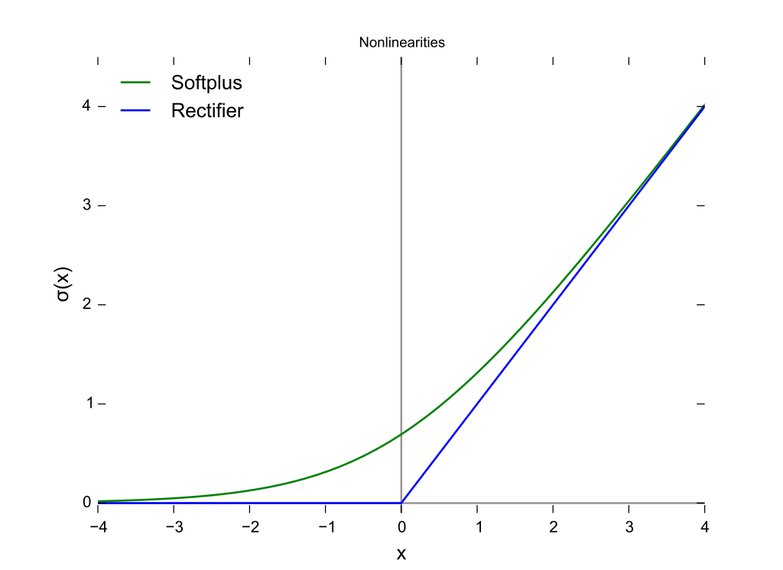
Sequence Model Architecture and Tuning*
Evaluation Metrics : Accuracy , Categorical Accuracy weighted accuracy
Note: Mean Per Class Error SHOULD be used to maximize accuracy across classes, however this is at the expense of total accuracy, so given lack of background into what products drive the greatest COST to the company, total accuracy was used.
Activation Function Leveraged for Initial Dense Layers(post embedding): Relu, Selu, Tanh, Softplus
RELU function returns 0 if it receives any negative input , but for positive value, it returns that value back
Prevents issues with exploding gradients (nothing is returned if value is < 0)
Activation Function For Dense Output Layer: Softmax
SoftMax is simple and informative for multi-class classification problems, as it will report back the “confidence score” for each class. Since we’re dealing with probabilities here, the scores returned by the SoftMax function will add up to 1.
This allows the end user to prioritize predicted outputs, and understand for Incorrect classifications, where the correct class falls within the likelihood of all classes.
Model Architecture Normalization
2 Drop out layers, evaluated with dropout of: 20%, 30
20% dropout between initial embedding layer first lstm network provided strongest generalization to test data
20% dropout between LSTM layer and dense output layer layer provided strongest generalization to test data
Total Epochs Considered Per Architecture: 10 (but early stopping used to prevent un-necessary training, 3 total needed)
TRANSFER LEARNING USED TO REDUCE TRAIN TIME AND IMPROVE EMBEDDING GENERALIZATION
Early stopping was enforced with no patience, so if accuracy of model from epoch1 beats model from epoch 2, we select model from epoch 1 based on validation performance metrics calculated at end of each epoch
*Due To limited time and resources, only very simple architectures where evaluated , all hyperparameters evaluated with exhaustive grid search. All the data should be scored and evaluated by the model to ensure stability before using this model in production.
Notes:
HyperParameters can be though of as “higher-level” properties of the model such as its complexity or how fast it should learn. Hyperparameters are model-specific properties that are ‘fixed’ before you even train and test your model on data.

